Slide 1
Ngā Tapuae
Māori Student Transitions
Marianna Pekar, Social Wellbeing Agency

Slide 2
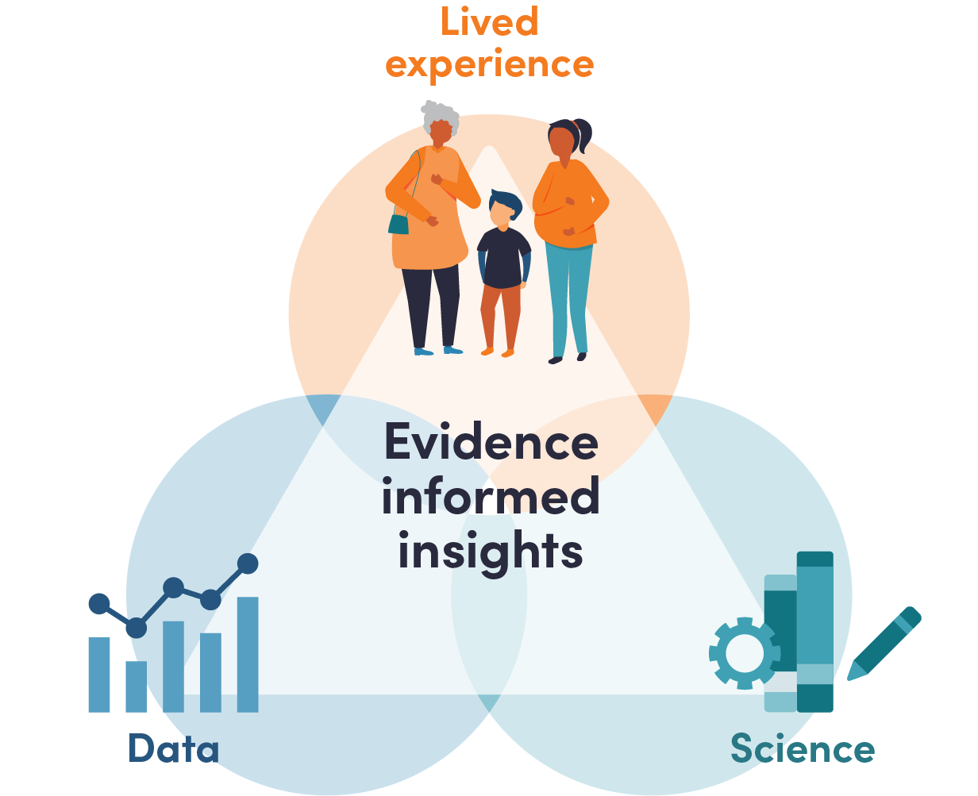
Ngā Tapuae: Looking for stepping stones together
Identify the most important barriers, levers and boosters that help young Māori to succeed
Complex problem, requiring a mixed methods model
Social Wellbeing Agency (SWA) and Tokona Te Raki partnered to design and execute this research
SWA – specialist in IDI, Tokona Te Raki – Ngāi Tahu lead educational initiative
Notes:
Kia ora, ko Marianna Pekar toku ingoa, he Principal Data Scientist ahau ki Toi Hau Tangata/Social Wellbeing Agency. Tena kotou katoa.
Can we give 15 year-old rangatahi living in the South Island good advice on what stepping stones will help them have a better life by 30? What are the boosters and levers to an early career, earning a good wage, having better physical and mental health?
These are questions, for which data alone can not give an answer to. Moving away from telling young people answers that do not reflect the complexity of their lives or are based on immutable or deficit-based measures is not helpful. Our goal was to consider the reality of rangatahi’ s lives and if possible, discover opportunities for system-level changes to design better pathways – with the help of data, evidence and lived experience.
Social Wellbeing Agency partnered with Tokona Te Raki, a Ngāi Tahu-led collaborative established to increase Māori participation and success in education and employment outcomes and co-designed the research project, Nga Tapuae meaning Stepping Stones.

Slide 3
Quantitative, qualitative and participatory techniques applied
Literature review
Pre-IDI qualitative
IDI research
Data Party
Post-IDI qualitative
Synthesis
Together
Tokona
SWA
Notes:
You can see the research plan of this mixed methods study, marking the quantitative components, performed by SWA, the qualitative ones, planned and executed by Tokona and the components, where synthesis and participatory techniques were used.
In reality, when planning this work, the starting point was the IDI research, experimenting with an unsupervised method, social sequence analysis to look for typical patterns in young Māori people’s lives in the Ngāi Tahu takiwā. The rest of the research was designed around it:
The literature review confirmed that the technique has been successfully used in early career transitions and the pre-IDI qualitative research helped focussing on useful measures in the vast dataset of the IDI.
Following the quantitative research, came a Data Party. We used this participatory technique to ensure proper knowledge transfer to the qualitative research team, which consisted of rangatahi of the same background and cohort as the study participants. My team built an R Shiny visualisation to view the complex analytics output and discuss interpretation and insights for the next phase.
The post-IDI qualitative phase involved showing selected data to focus groups and validating the common life paths we observed in the data, going beyond what data can tell.
Finally the SWA and Tokona teams came together to a final phase of synthesizing findings.

Slide 4
Representative timelines found stepping stones pathways
Dataset with individuals’ simplified timelines
Create the population
Define measures
Set the time window and time increments
Summarise timelines
Visualisation
Manual segments
Algorithmic segments
Observe timelines of “typical” (synthetic) individuals
Notes:
How did the IDI research look like? Once we defined the study population and measures of interest, we set an observation window of 15 years. We created representative timelines based on social sequence analysis. The outputs were two types of representative timelines: we clustered individuals’ timelines using optimal matching and named them – based on whether they represented a path to prosperity or the opposite. There was a clear ranking and we found the ideal number of clusters to be 4. For Tokona’s request we also created timelines for some user-defined groups of interest young people who attended Kura Kaupapa.
Visualisation is an important part of this exploratory method. We have obtained over 200 measures from numerous IDI sources, grouped them into 34 broader topics for over 100 subpopulation groups, forming a representative timeline for these across all variables. These results were loaded into an R shiny app which provides endless ways of comparing groups and creating unique timelines. It is too large to take with me and demonstrate in this 5 minutes. So I’ll jump to the results.

Slide 5
Results
Those who studied in Kura Kaupapa at some point during their last three years of high school had better academic outcomes by the age of 23.
Those who completed at least one science subject with achievement level Merit or Excellence at NCEA level 1 are more likely to have finished a tertiary degree by the age of 23.
Tertiary qualifications are still a gateway to higher earnings and better overall outcomes.
49% relative increase in likelihood for those with a tertiary qualification earning over NZD 70,000 by age 30.
Those holding a tertiary qualification are more likely to have earned over NZD 70,000 by the time they are 30, compared to those who attained Level 4-6 qualifications.
Use of mental and chronic health services are also lower for the group with higher educational attainment.
21.4% relative difference in university eligibility.
Those who studied in Kura Kaupapa at some point during their last three years achieved higher rates of university entrance compared to the study population.
31.8% relative difference in completing Level 3.
Those who studied in Kura Kaupapa at some point during their last three years completed Level 3 at a higher rate compared to the study population.
5% relative difference in completing a Bachelor’s degree.
Those who studied in Kura Kaupapa at some point during their last three years completed a Bachelor’s degree at a higher rate compared to the study population.
79% relative increase in likelihood that those who achieve at least one science subject at NCEA Level 1 with Merit or Excellence finish a tertiary degree by the time they are 23.
This is compared to the same measure for those who started and did not complete the science subject or completed the subject with Achieved at NCEA Level 1.
Contact details:
Marianna.Pekar@swa.govt.nz Joel.Bancolita@swa.govt.nz
swa.govt.nz/publications/guidance/
github.com/nz-social-wellbeing-agency/nga_tapuae
Notes:
These will be published by Tokona however have some preliminary insights to show:
Tertiary education is still the gateway to better incomes, better physical and mental health, however the benefits only show close to the age of 30.
Those who attended Kura Kaupapa had better academic outcomes that followed them beyond their years in high school.
Finally, achievements in different subject areas have varying effect on young people’s lives after high school. Sciences and Mathematics seemed to be particularly important. As early as on NCEA level 1, achievement of merit and excellence meant that the likelihood of finishing a university degree by the age of 23 increased by 79%. Rangatahi explained that being streamed out of high achieving classes therefore have long-lasting effects on their chances of performing in high school and academia.
I hope you enjoyed this presentation. If you are interested in more details, talk to me or Joel and visit our website.

